Slide 1
Guessing game

Slide 2
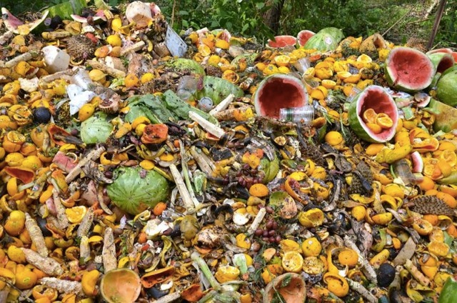
Vegetable matter /ˈvedʒtəbl/ /ˈmætər/ (n)

Slide 3
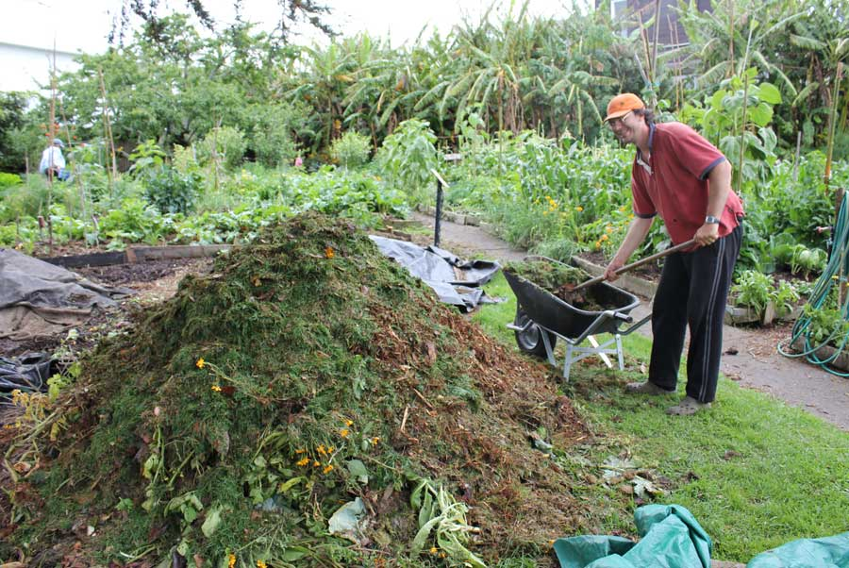
compost heap /ˈkɑːmpoʊst//hiːp/ (n)

Slide 4
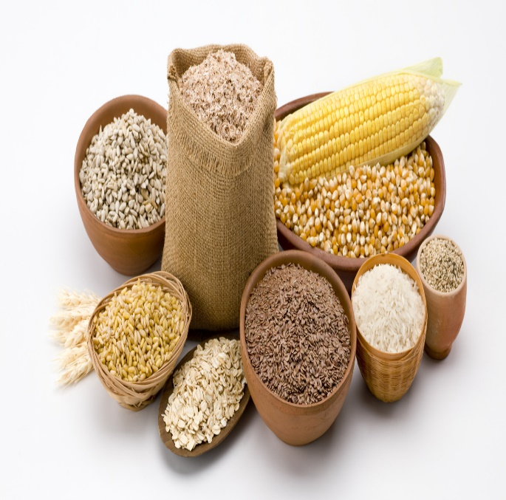
grain products /ɡreɪn/ /ˈprɑːdʌkt/ (n)

Slide 5
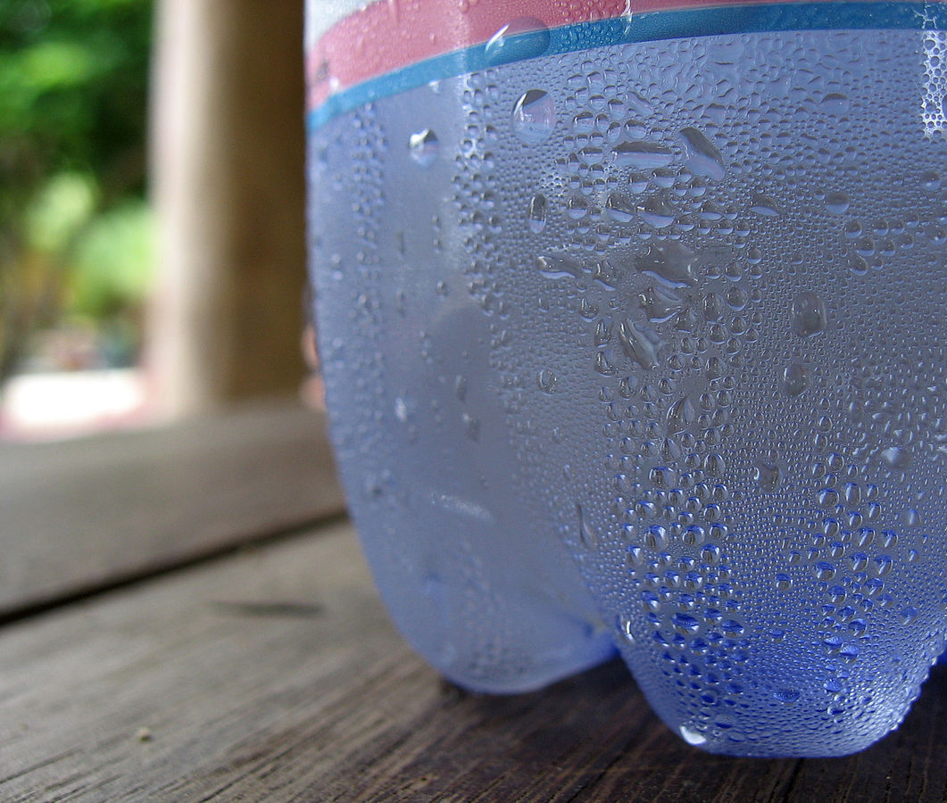
condensation /ˌkɒn.denˈseɪ.ʃən/

Slide 6
Unit 10 Recycling Part 3: Listen/91

Slide 7
I/ Vocabulary
vegetable matter /ˈvedʒtəbl/ /ˈmætər/: (n) | Lớp phủ thực vật
compost heap /ˈkɑːmpoʊst/ /hiːp/ (n): | Đống phân hữu cơ
grain products /ɡreɪn/ /ˈprɑːdʌkt/ (n): | Sản phẩm ngũ cốc
condensation /kɒn.denˈseɪ.ʃən/ (n): | Sự ngưng tụ

Slide 8
You are going to listen to an expert talking about way to make compost ,think about these sentences:
1) What type of garbage can you put in the compost ?
2) Where is the best place for a compost heap ?
3) Should you water the compost ?
4) How long does it take before you can use the compost ?

Slide 9
1. Listen twice then put the words into correct order to make compost.
moisture
vegetable matter
rats
garabage
start
six
sunlight
a. What type of ……….......(1) can you put in the compost?
Today I'm going to explain how to..…… (2) a compost heap. First of all, you must use only…………………………. (3) includes tea leaves, egg shells - but wash the shells first - and tissues. Don't use any meat or grain products because this attracts……. (4).
b. Where is the best place for a compost heap?
Find a place in your garden that gets a few hours of ……………(4) each day. Use pick or shovels to turn the compost regularly so it gets plenty of air.
c. Should you water the compost?
The compost also needs…………..…(5), but it will get this from condensation. Cover the heap with a sheet of strong plastic if the weather is very wet.
d. How long does it take before you can use the compost?
Keep adding to the pile and after about …… (6) months, your compost will be ready to use as fertilizer.

Slide 10
2. Listen one more time to choose the correct option.
1) What type of garbage can you put in the compost?
A. all vegetable matter
B. meat or grain products
2) Where is the best place for a compost heap?
A. a place that gets no sun
B. a place that gets sun and shade
3) Should you water the compost?
A. Yes
B. No
4) How long does it take before you can use the compost?
A. after it rains
B. six months
A
B
B
B

Slide 11
3. Ordering Put these phrases in the correct order to make compost
Use pick or shoves to turn the compost regularly
Start a compost heap
Cover the heap with a sheet of strong plastic
Place in the garden
Use as fertilizer
Keep for six month
1. | 2. | 3. | 4. | 5. | 6.
B
D
A
C
F
E

Slide 12
Homework
- Learn by heart the vocabulary.
Answer the question “Why should we make compost?”
Prepare: Read P.92.

